Slide 1


Introduction to Full Stack Web Development

Slide 2
Objective
Full Stack Web Development Concept
The MERN Stack
Web Developer Responsibilities
Crucial Knowledge for Back-End Development
Crucial Knowledge for Front-End Development

Slide 3
Welcome to Level 2!
Here is an overview of what will be covered in this level:
1: Introduction to Full Stack Web Development | 2: Advanced JavaScript | 3: ReactJS I (Introduction to ReactJS) | 4: ReactJS II (Components)
5: ReactJS III (Events) | 6: ReactJS IV (States) | 7: Deploy your React app | 8: React V (Fetching data)
9: React VI (Testing a React App) | 10: Introduction to Node.js | 11: Express Web Framework I | 12: Express Web Framework II
13: Full stack with React and Express | 14: Testing and Refactoring Express | 15: Capstone Project: ReactJS
Advanced features of JavaScript
React
Node.js and Express
Capstone Projects

Slide 4
Full Stack Web Development
A web developer should create custom code for a client’s unique needs
Web development has 3 parts:
Client-side scripting: executes in a web browser and determines what your customers or clients will see on your website
Server-side scripting: executes on a web server and powers the behind-the-scenes mechanics of how a website works
Database technology: stores and manages all data needed for your web application (this will come in level 3)

Slide 5



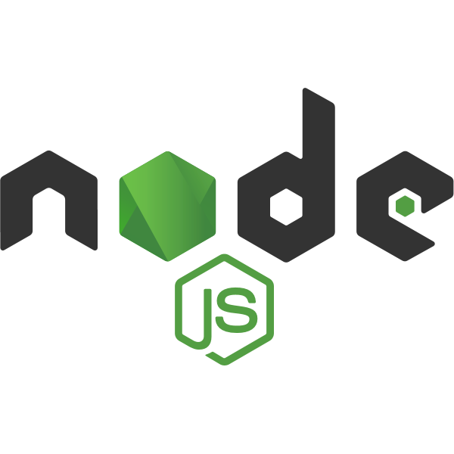
The MERN Stack
Stack: a collection of technologies that are used together to create a web app (e.g. LAMP stack, MEAN stack & MERN stack)
JavaScript is used for full stack web development using a combination of frameworks and libraries
The most popular approach is the MERN stack
MongoDB
Express JS
React JS
Node JS

Slide 6
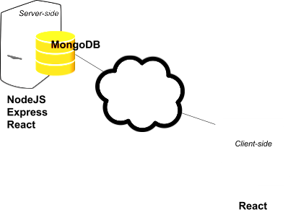
The MERN Stack
React: library created by Facebook to create views that are rendered in HTML. It is isomorphic.
MongoDB: non-relational database that stores data as documents or objects. It uses a query language based on JSON.
Node.js: allows JavaScript to be used on web servers, not just a browser.
Express: unopinionated web framework for development using Node.js.

Slide 7
Web Developer Responsibilities
Front-End Developer:
Prioritising user experience
Bringing a designer’s concept to life
Production and maintenance of websites and web app user interfaces
Creating tools that enhance user interaction in any browser
Implementing responsive design for mobile sites
Using a project management tool like GitHub to maintain software workflow management
Looking at search engine optimisation (SEO) best practices
Testing the site for usability and fixing bugs during development

Slide 8
Web Developer Responsibilities
Back-End Developer:
Database creation, integration and management
Using back-end frameworks (e.g.Express.js) to build server-side software
Web server technologies
Cloud computing integration
Server-side programming languages
API integration
Content management system development, deployment and maintenance
Security settings and hack prevents
Reporting, generating analytics and statistics
Backup and restore technologies for a website’s files and database

Slide 9
Web Developer Responsibilities
Full Stack Developer:
Server, Network and Hosting Environments
Data modelling
Business Logic
User Interface
User experience
Customer and business needs
Notes:
Server, Network and Hosting Environments: i.e. understanding what can break and why; appropriate use of the file system, cloud storage and network resources; knowing application scale, given the hardware constraints; and working side by side with DevOps
Data Modeling: i.e. knowing how to create a reasonably normalised relational model, complete with foreign keys, indexes, views, lookup tables, etc; being familiar with the concept of non-relational data stores and understanding where they shine over relational data stores
Business Logic: i.e. having solid object-oriented skills
API layer/Action Layer/MVC: i.e. knowing how the outside world operates against the business logic and data model; using frameworks; being able to write clear, consistent and simple-to-use interfaces
User Interface: i.e. understanding how to create a readable layout; being able to acknowledge the need for help from artists and graphic designers to implement a good visual design; using HTML5 and CSS; using JavaScript (node, backbone, knockout etc.)
User Experience: i.e. being able to build web applications that offer users a pleasant experience when interacting with them. For example, being able to step back and look at a process that currently needs seven clicks and four steps and get it down to just one click; write useful error messages
Customer and Business Needs: i.e. having a grasp of what is going on when the customer uses the software; having a grasp of the customer’s business

Slide 10
Crucial Knowledge for Back-End Development
Web apps are usually backed up by 2 types of servers:
Web servers
Application servers
Web servers: computer with an internet connection and software to make web pages available to clients.
Stores resources for web apps, e.g. images, HTML, CSS and JS files
Must have software that allows it to act as an HTTP server
Notes:
The HyperText Transport Protocol (HTTP) is used by web browsers to communicate with web servers. An HTTP request is sent from your browser to the target web server whenever you click a link on a web page, submit a form or run a search. Web servers wait for these request messages and then process them when they arrive. The web servers then reply to the web browser with an HTTP response message.
A static website returns the same hard-coded content from the web server whenever a particular resource is requested.

Slide 11
Crucial Knowledge for Back-End Development
Application servers: contain the business logic needed to build resources to be passed back to the browser.
Usually have a web framework running on it
Framework is able to match requests and dynamically generate responses.

Slide 12
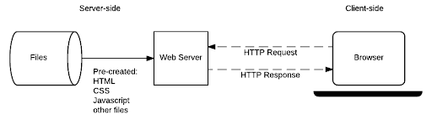
Crucial Knowledge for Back-End Development
Web Server Architecture for a Static Site (developer.mozilla.org)
Notes:
If you only want your website to serve static pages, then you only need a web server.

Slide 13
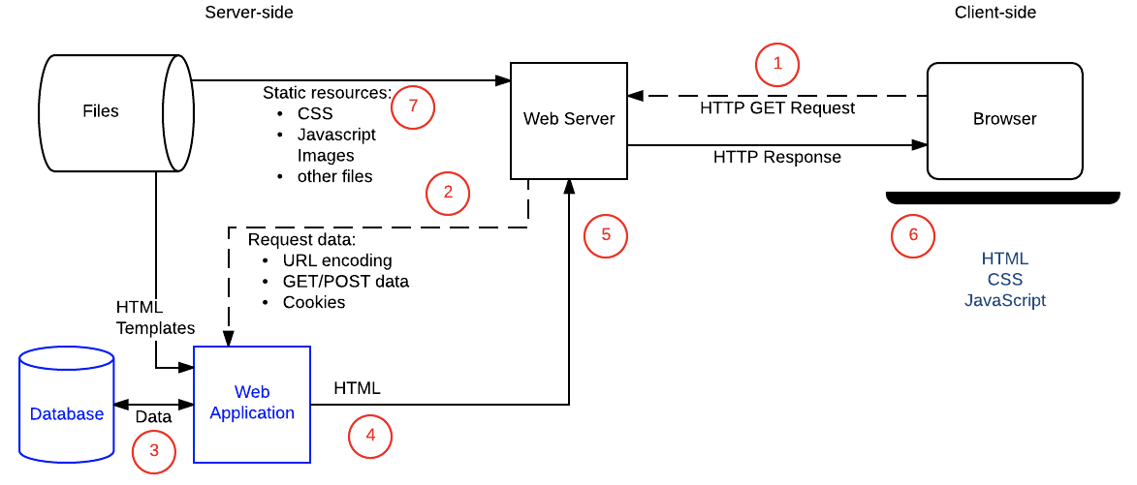
Crucial Knowledge for Back-End Development
Web Server Architecture for a Dynamic Site (developer.mozilla.org)
Notes:
However, if you want to build a web application that responds to requests with dynamic resources, then you need a web server and an application server.
Typically a reverse proxy sits in front of your web servers and web application servers and routes traffic to the appropriate server. An application server is most likely run as a proxy of a web server. The web server usually just passes non-static requests to the application server.

Slide 14
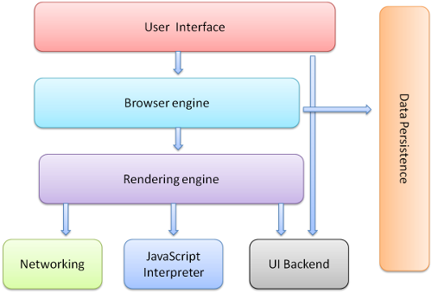
Crucial Knowledge for Back-End Development
How does a browser actually work?
Notes:
The user interface: the interface that you interact with when you open a browser. It includes the address bar, back, forward and refresh buttons etc.
The rendering engine: displays the requested content. By default, the rendering engine can display parse and display HTML and XML documents and images.
The browser engine: takes inputs from the user interface (e.g. the URL input by the user) and sends this to the rendering engine and vice-a-versa.
Networking: used for making for network calls such as HTTP requests.
UI backend: allows the browser to interface with your devices operating system.
JavaScript interpreter: used to parse and execute JavaScript code.
Data persistence: used to store data such as cached files, cookies, sessionStorage and localStorage.

Slide 15

Crucial Knowledge for Back-End Development
Rendering engine does the following to render the page:
Notes:
Firstly, the browser parses the HTML to create a DOM tree. The CSS is then parsed and combined with the DOM tree to create a render tree which described not only what elements should be rendered but how these elements should be styled. The render tree doesn’t describe where on the page the various elements in the DOM tree should be positioned - this happens during the layout process. Finally, all the elements are ‘painted’ to display them in the browser UI.

Slide 16
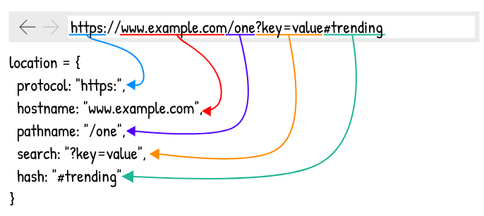
Crucial Knowledge for Back-End Development
Single Page Application (SPA): “an application that loads a single HTML page and all the necessary assets (such as JavaScript and CSS) required for the application to run. Any interactions with the page or subsequent pages do not require a round trip to the server which means the page is not reloaded.” (by React).
Notes:
Usually, when the location object changes, the browser makes a new request to the server and creates a new Document (that describes and provides methods for interacting with the DOM) based on the response it receives. However, with a SPA a new Document is NOT created every time the Location object changes. Rather a SPA will reuse and update the active Document when the location changes instead of making a new request to the server. It uses the History API to do this. When we created React applications using Create React App, we created single-page applications. Some SPAs use server-side rendering.

Slide 17
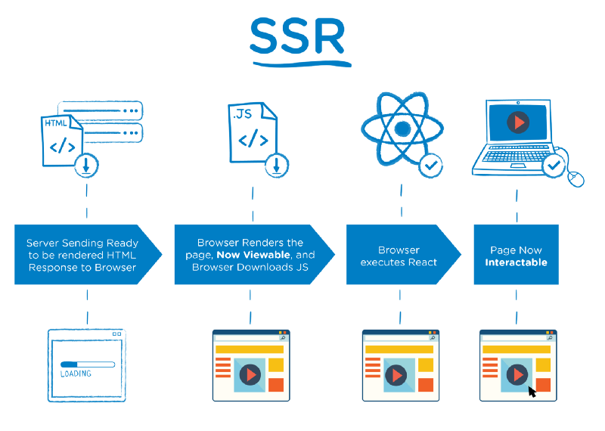
Crucial Knowledge for Back-End Development
Server Side Rendering (SSR): taking a JavaScript framework (like React) and rendering it to static HTML and CSS on the server.
Notes:
In server-side rendering when a user makes a request to a webpage, the server prepares an HTML page by fetching user-specific data and sends it to the user’s machine over the internet. The browser then construes the content and displays the page. This entire process of fetching data from the database, creating an HTML page and sending it to client happens in mere milliseconds.
Now Imagine that a user clicks a link on the page, the browser sends a request to the server and the entire process is carried out by the ser

Slide 18
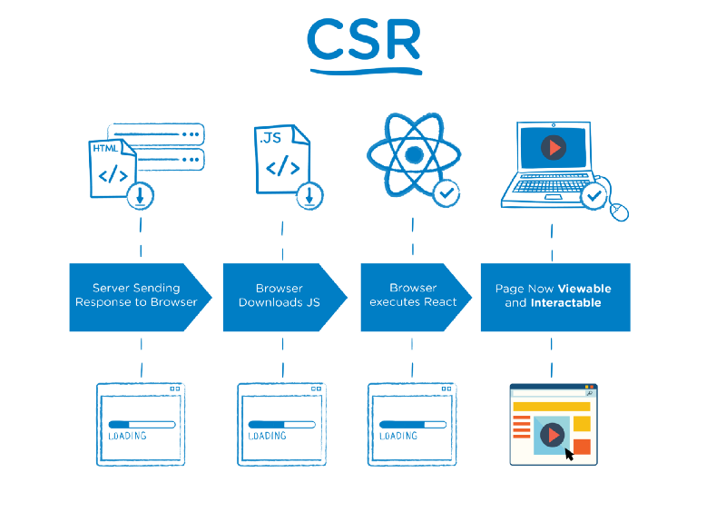
Crucial Knowledge for Back-End Development
Client Side Rendering (CSR): your browser will start rendering the HTML from your server without having to wait for all the JavaScript to be downloaded and executed.
Notes:
Client-side rendering is a reasonably new approach to rendering websites, and it didn't really become popular until JavaScript libraries started incorporating it.
When we talk about client-side rendering, it’s about rendering content in the browser using JavaScript. So instead of getting all the content from the HTML document itself, a bare-bones HTML document with a JavaScript file in initial loading itself is received, which renders the rest of the site using the browser.
With client-side rendering, the initial page load is naturally a bit slow. However, after that, every subsequent page load is very fast. In this approach, communication with server happens only for getting the run-time data. Moreover, there is no need to reload the entire UI after every call to the server. The client-side framework manages to update UI with changed data by re-rendering only that particular DOM element.
Today, Angular and React.js are some of the best examples of libraries used in client-side rendering.
To help you understand the pros and cons of each approach, listed below are a few pointers that will guide you towards the right decision.

Slide 19
When to use server-side rendering
An application has very simple UI with fewer pages/features
An application has less dynamic data
Read preference of the site is more than write
The focus is not on rich site and has few users

Slide 20
When to use client-side rendering
An application has very complex UI with many pages/features
An application has large and dynamic data
Write preference of the site is more than reading
The focus is on rich site and a huge number of users

Slide 21



Resources
https://www.html5rocks.com/en/tutorials/internals/howbrowserswork/#The_browser_high_level_structure
https://www.html5rocks.com/en/tutorials/internals/howbrowserswork/#The_main_flow
https://blog.pshrmn.com/entry/how-single-page-applications-work/
https://medium.com/walmartlabs/the-benefits-of-server-side-rendering-over-client-side-rendering-5d07ff2cefe8

Slide 22
Summary
Full Stack Web Development Concept
The MERN Stack
Web Developer Responsibilities
Crucial Knowledge for Back-End Development
Crucial Knowledge for Front-End Development

